Slide 1
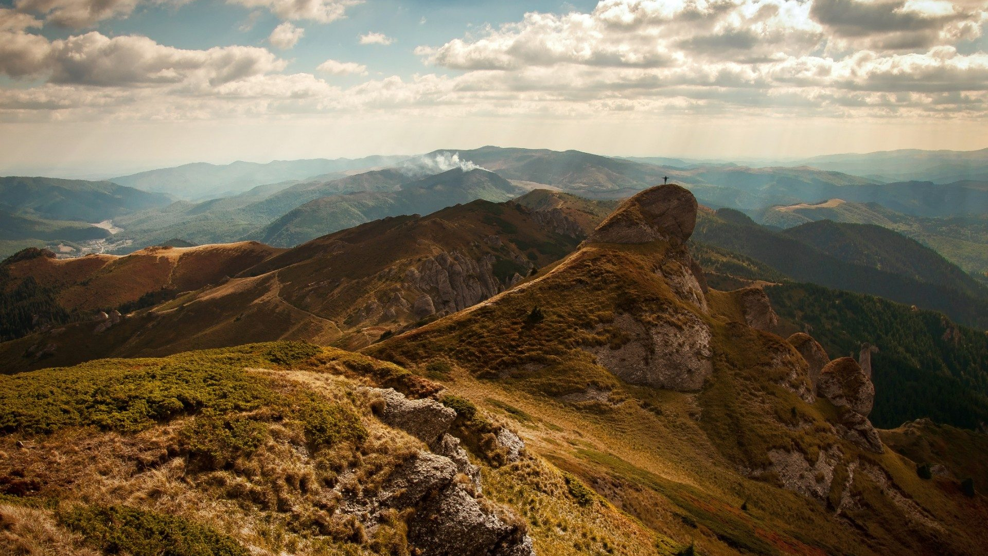

FRIENDS day: Big data
Typical day of a big data engineer
https://github.com/sergysta/bd-workshop-may.git
May 2019
by Sergei Stafeev

Slide 2

AGENDA
1
Big Data Overview
2
Case Study: Problem Overview
3
Case Study: Environment
4
Case Study: Narrowing Down

Slide 3
BIG DATA Overview

Slide 4
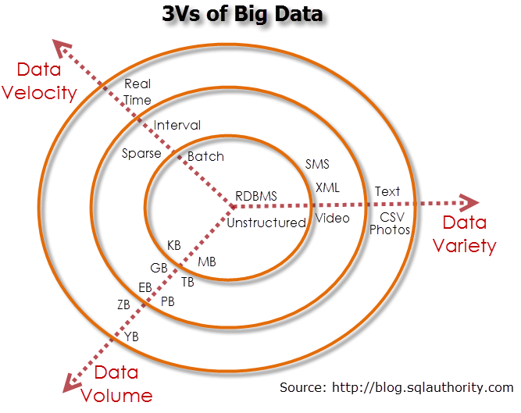
{Prerequisites #1

Slide 5
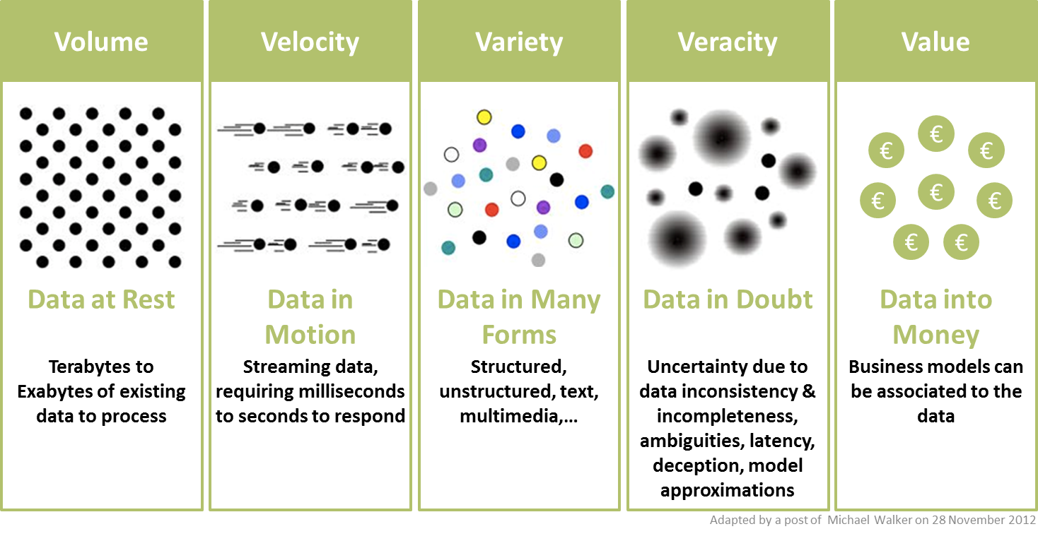
{Prerequisites #2

Slide 6
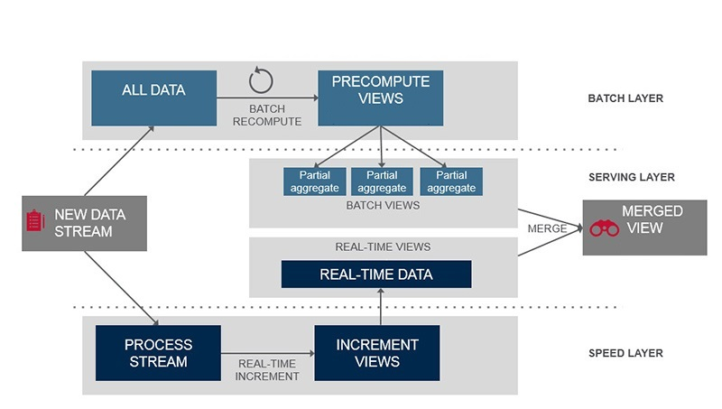
{Big Data approach: Lambda Architecture

Slide 7
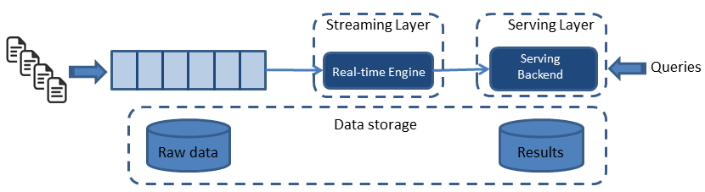
{Big Data approach: KAPPA Architecture

Slide 8
Case study: PROBLEM OVERVIEW

Slide 9
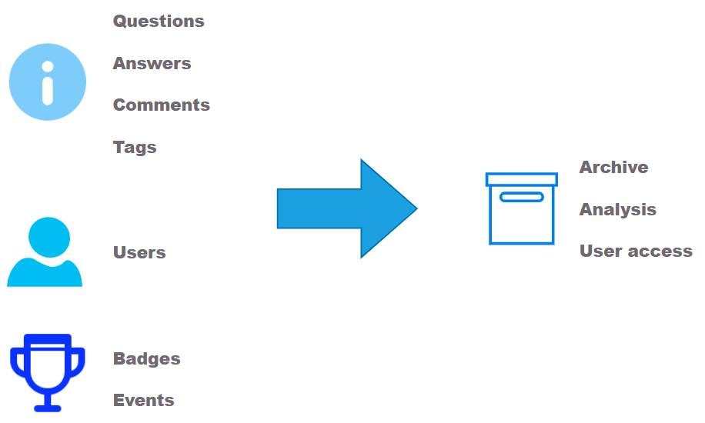
STACKOVERFLOW DATA ETL-PIPELINE

Slide 10

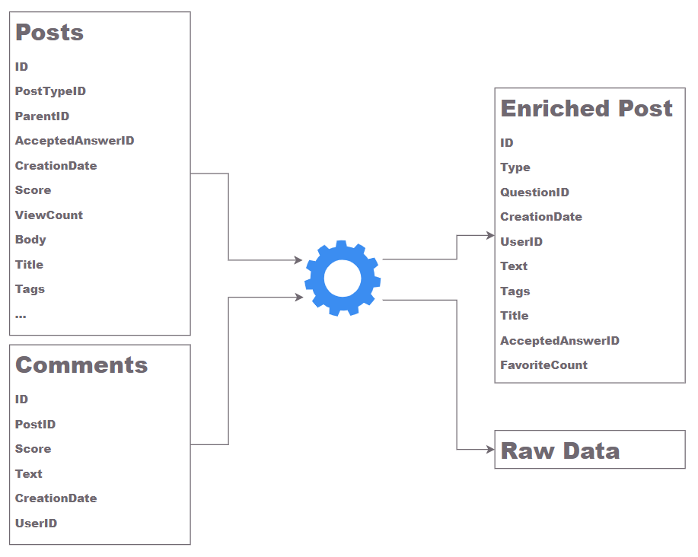

DATA SOURCES
Public dump
Stack Exchange API

Slide 11
Case study: Environment

Slide 12
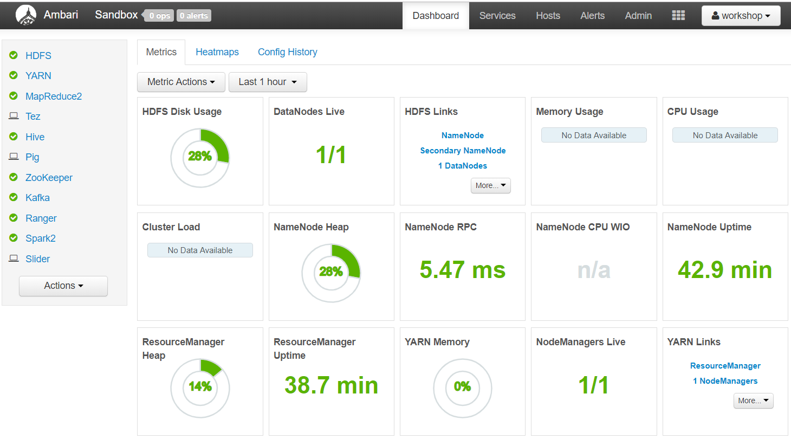
Hortonworks data platform

Slide 13
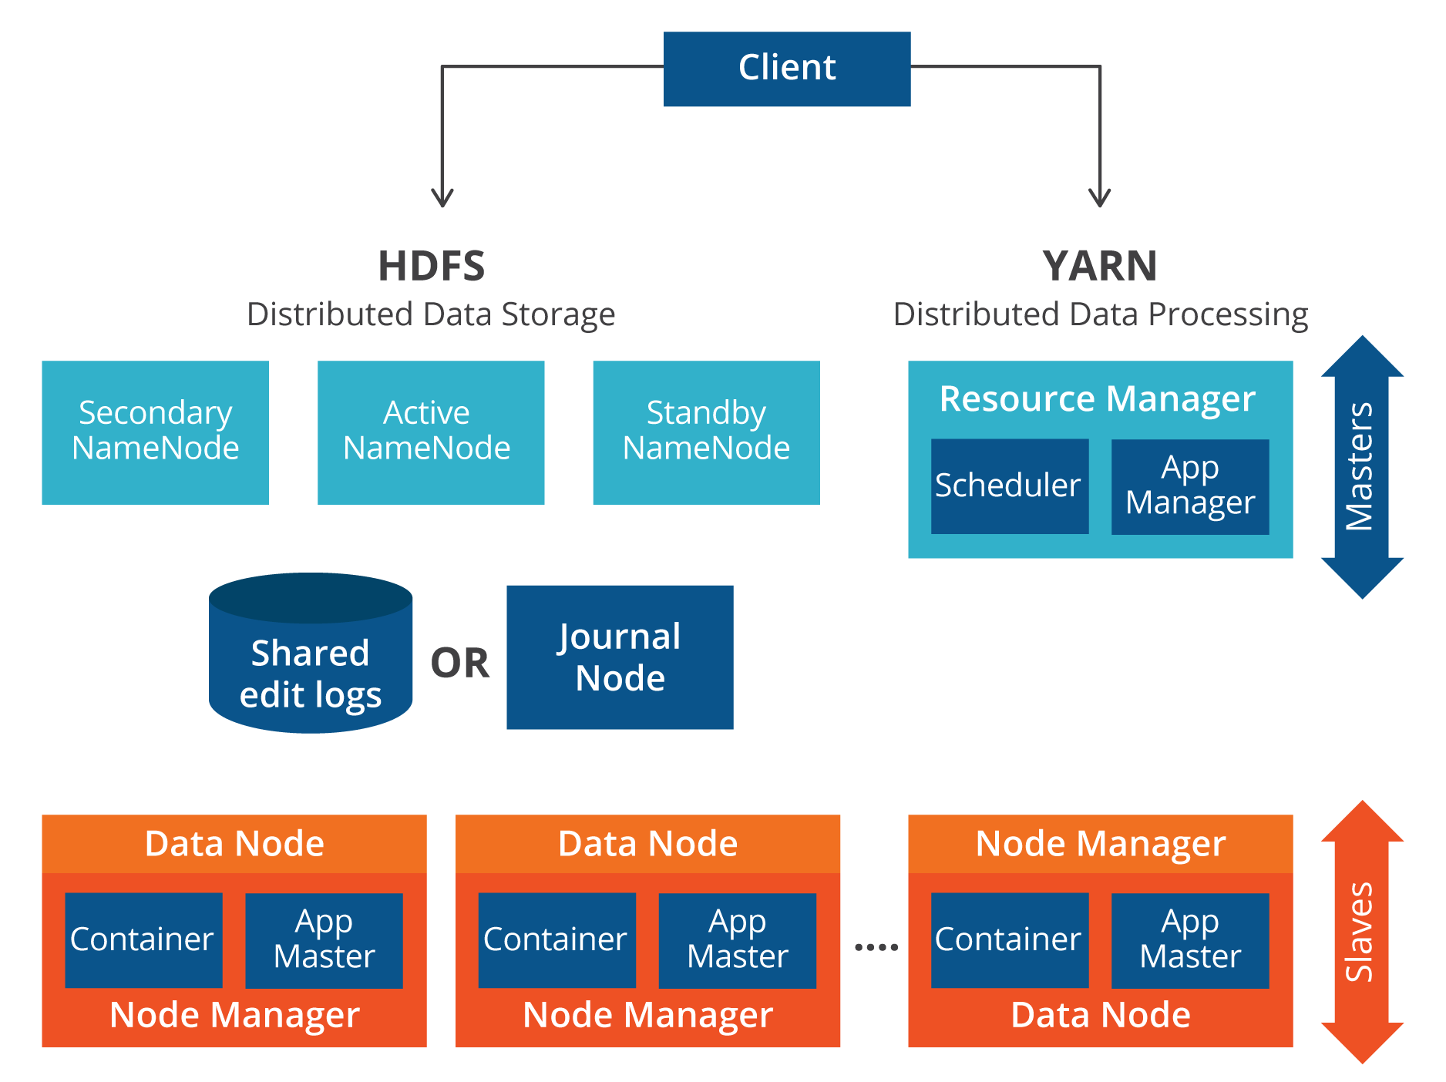
hadoop

Slide 14

hdfs

Slide 15
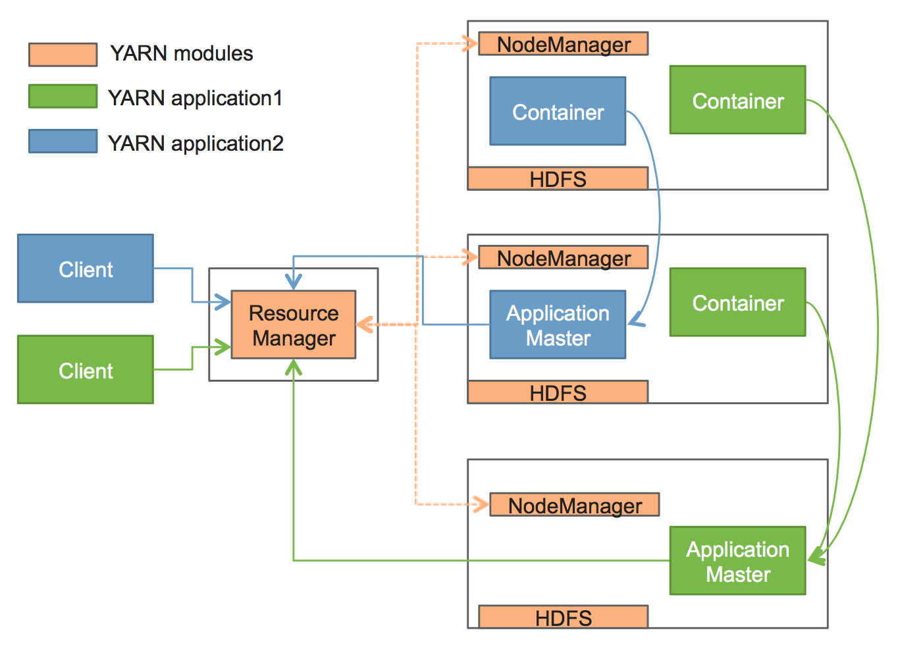
YARN

Slide 16
Case study: Narrowing down https://github.com/sergysta/bd-workshop-may.git

Slide 17
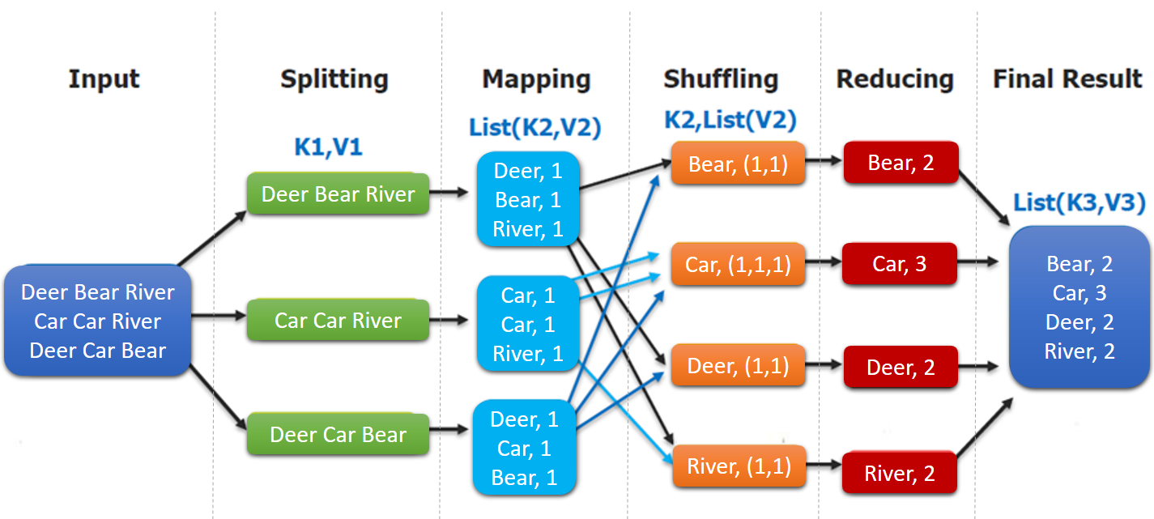
mapreduce

Slide 18
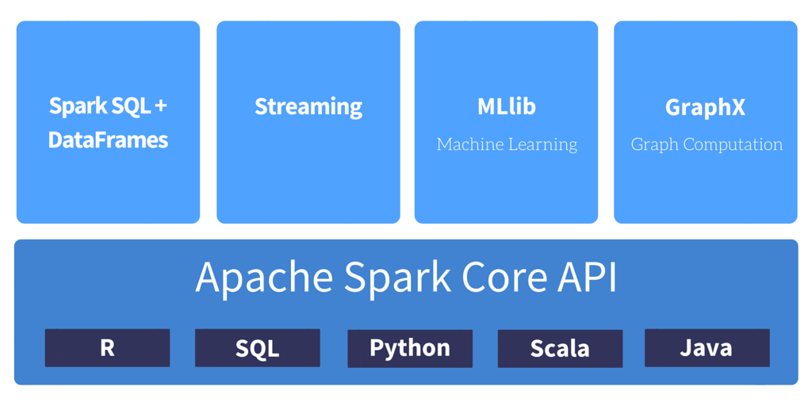
SPARK

Slide 19
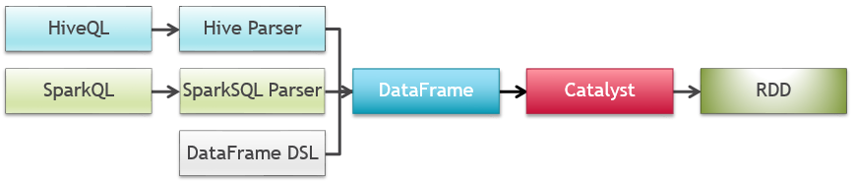
SPARK SQL

Slide 20

PROCESS STACKOVERFLOW DUMP

Slide 21
Hive

Slide 22

DATA ANALYSIS

Slide 23
ELK: Elasticsearch, logstash, kibana

Slide 24
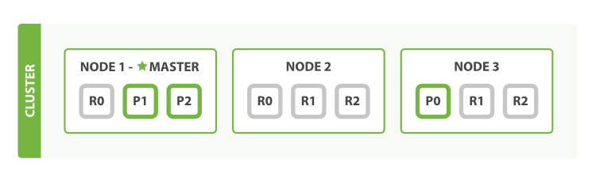
ELASTICSEARCH

Slide 25
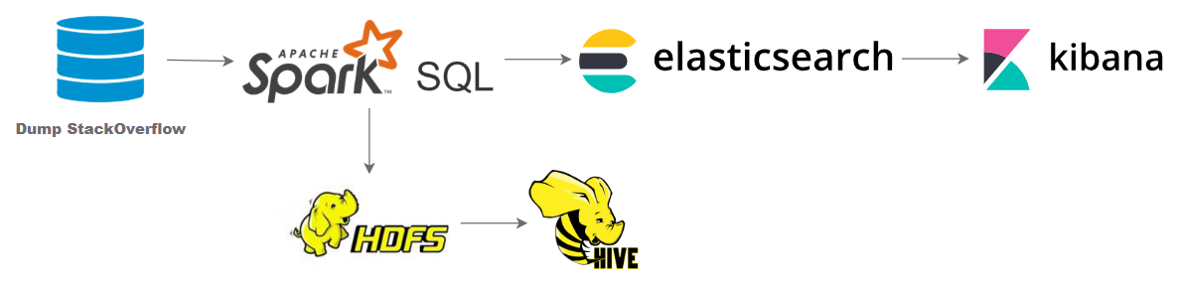
provide data for user interface

Slide 26
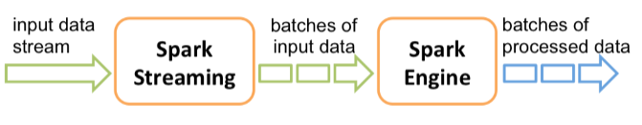
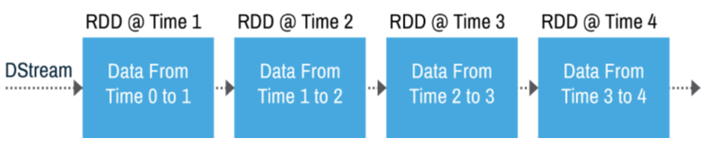
Spark streaming

Slide 27

Add streaming data processing

Slide 28
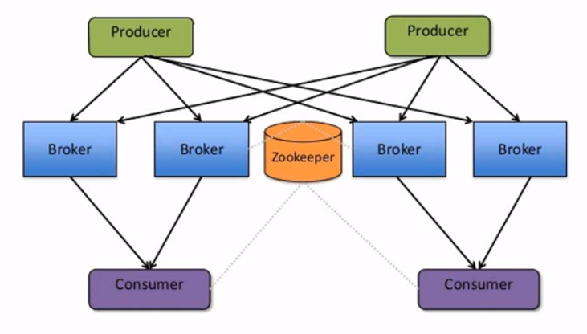
kafka

Slide 29
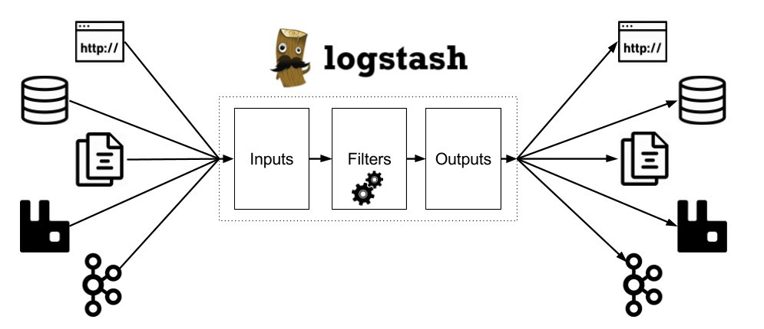
logstash

Slide 30
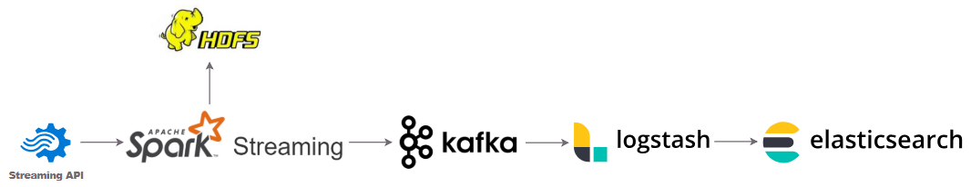
Provide streaming data for user interface

Slide 31
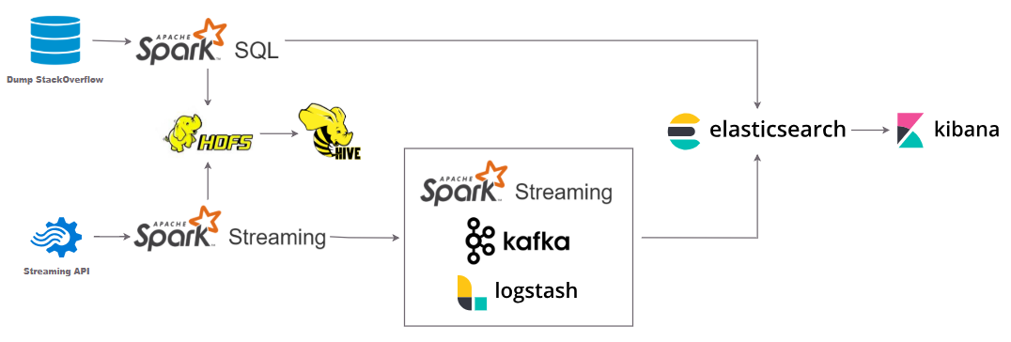
Solution overview

Slide 32
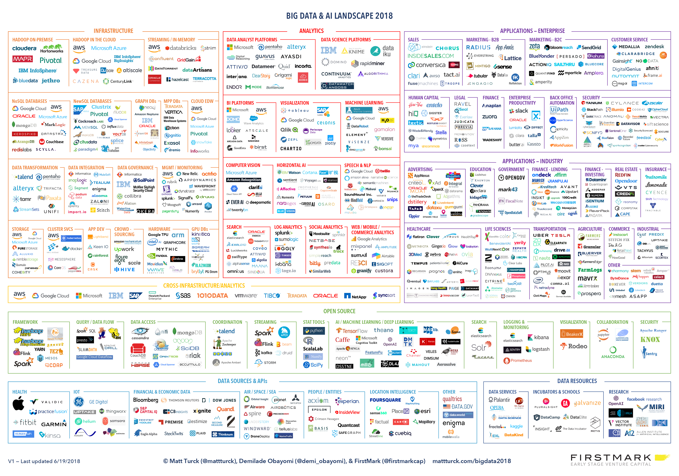
Never stop learning

Slide 33

Thank You!

